Slide 1

Howard Astronomical
League
Galaxy Quest

Slide 2
Celestial Observations
Stars and Constellations
Solar System Objects – Sun, Moon, Planets
“Faint Fuzzies” – Deep Sky Objects
  Comets
  Nebula
  Clusters
  Galaxies

Slide 3
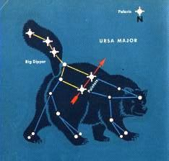
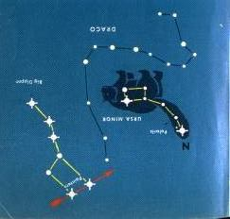
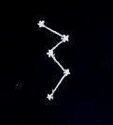
Stars & Constellations

Slide 4
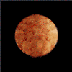
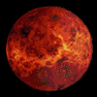
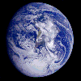
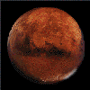
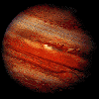
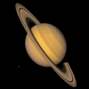
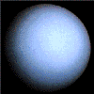
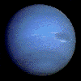
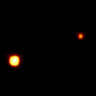
Planets
Mercury
(My)
Venus
(very)
Earth
(energetic)
Mars
(mother)
Jupiter
(just)
Saturn
(served)
Uranus
(us)
Neptune
(nut)
Pluto
(pudding)

Slide 5
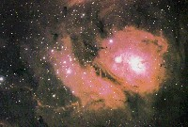
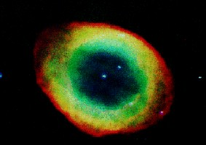
The Deep Sky
Nebulae
  Diffuse Nebulae - Clouds of interstellar matter that are thin, widespread trails of gas and dust (Sometime new stars are formed here) (M8)
  Planetary Nebulae - Outer portion of a star that was ejected by a hot central star (M57)

Slide 6
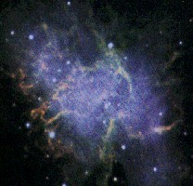
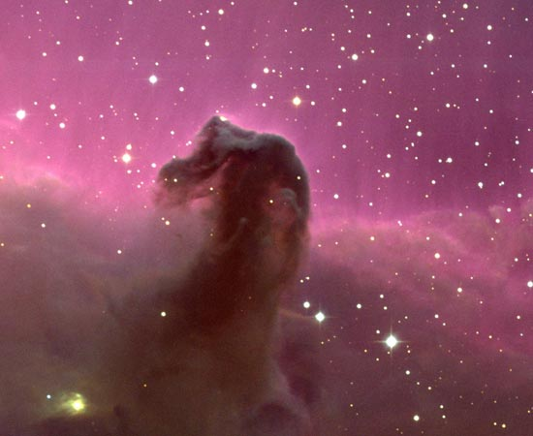
The Deep Sky
Nebulae
  Supernova Remnants - Dust and gas left over from a large star that exploded (Crab Nebula)
  Dark Nebulae - these dust clouds are only visible by the absorption of light from objects behind them

Slide 7
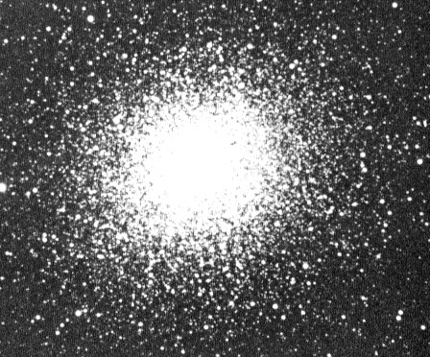
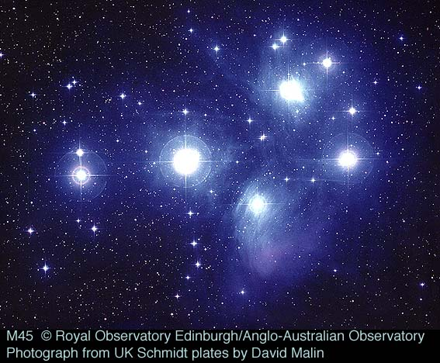
The Deep Sky
Star Clusters
  Globular clusters are gravitationally bound concentrations of approximately ten thousand to one million stars (M13)
  Open (or galactic) clusters are physically related groups of stars held together by mutual gravitational attraction (M45)

Slide 8
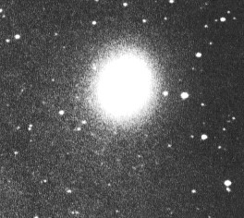
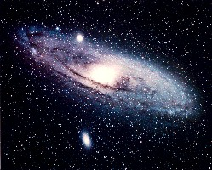

The Deep Sky
Galaxies
  Spiral - two major components: A flat, large disk and young star clusters
    Our sun is one of several 100 billion stars in a spiral galaxy, the Milky Way.
  Lenticular (S0) These are, in short, "spiral galaxies without spiral structure" - flat disks (older).
  Elliptical - Elliptical galaxies are of ellipsoidal shape - like a football
  Irregular - Everything else

Slide 9
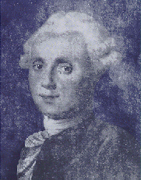
The Messier Objects
Charles Messier (1730 – 1817)
A French astronomer and the Greatest Comet hunter of his time
Influenced by a bright comet in 1744, Messier left home at the age of 21 to pursue his dreams
Messier was credited with the discovery/recovery of 13 comets during his career
Messier occasionally came across objects that looked like comets, but were not. He published 3 catalogues describing 103 deep sky objects

Slide 10
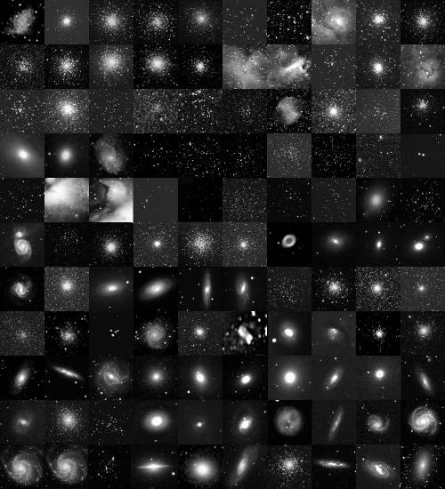
110 MESSIER OBJECTS

Slide 11
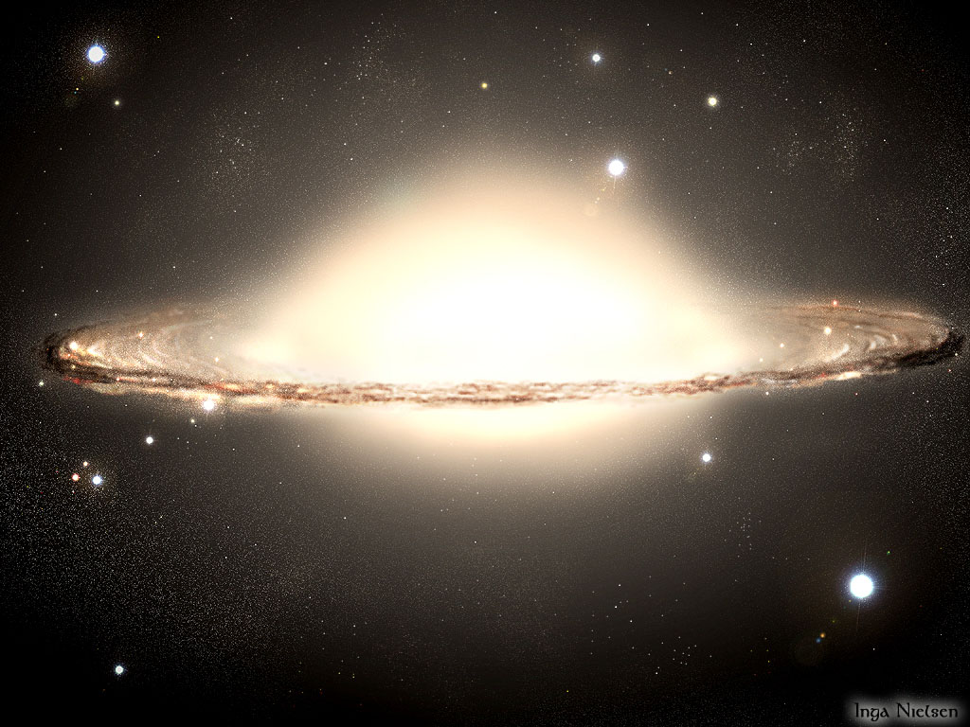
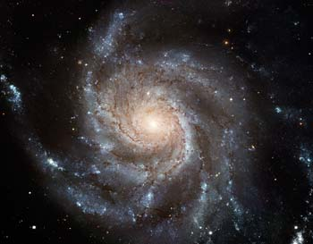
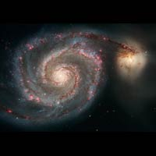
Spectacular Examples
Sombrero Galaxy M104
Pinwheel M101
Whirlpool M51

Slide 12
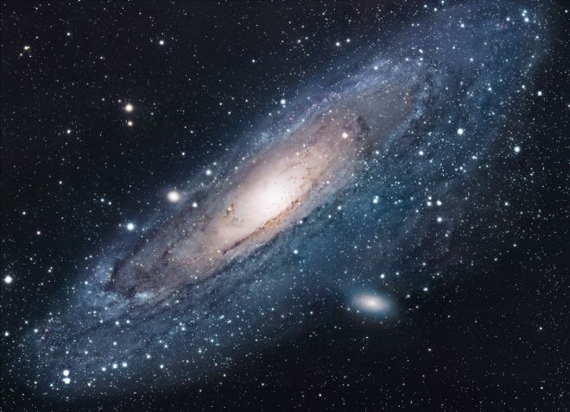
Andromeda Galaxy (M31)
Barred Spiral Galaxy, 2.5 Million Light Years, 1 Trillion Stars

Slide 13
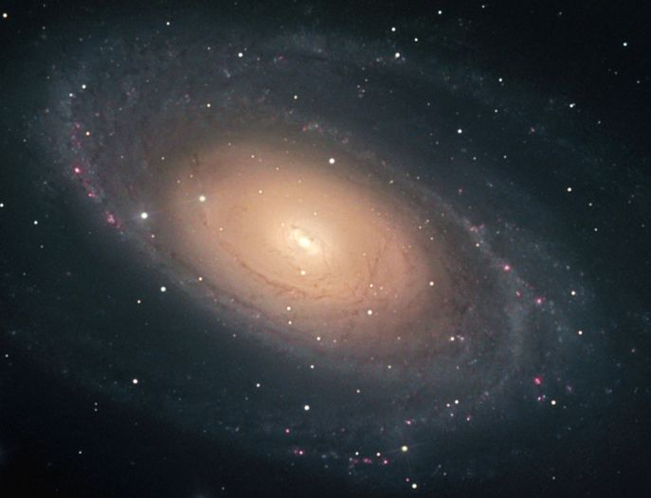
Bode’s Galaxy M81
Spiral Galaxy – 13 Million Light Years, 250 Billion Stars

Slide 14
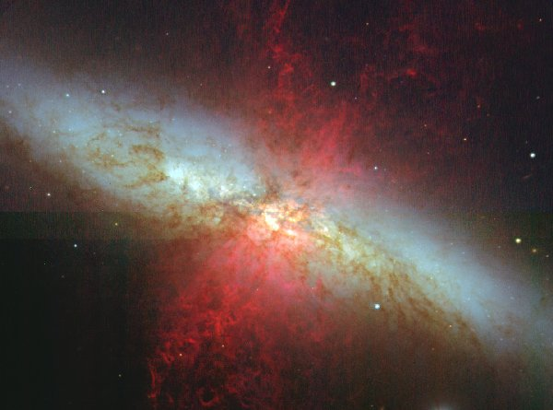
Cigar Galaxy (M82)
Irregular Galaxy – 12 Million Light Years Distant

Slide 15
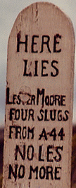
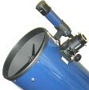
Telescope Observing Basics
Keep your eye about 1/2 inch away from the eyepiece
Let us know when you see the target
  If you cannot see the target the HAL member will center the target
Ask questions
Have fun
Please do not touch the eyepiece

